Slide 1
Imagerie numérique
Examen

Slide 2
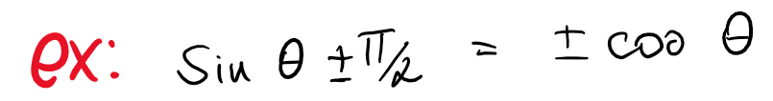
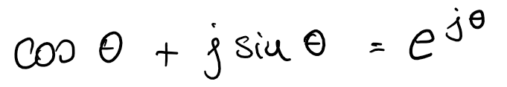
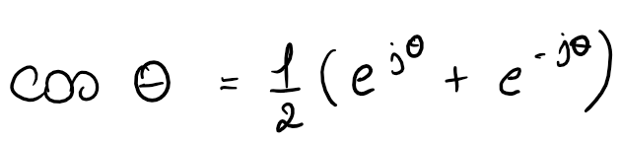
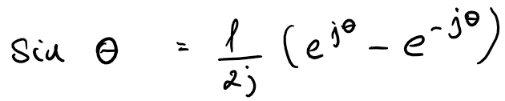
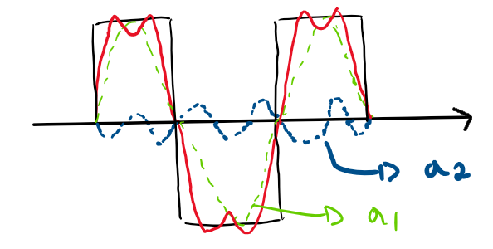
Fourier series. Explain the main principles of periodic function approximation. Explain 3 forms of Fourier series approximation (it can be interpreted as an inverse transform).
1.1
First thing we must know is that we can write cos as a function of a sin function by adding a phase shift:
We must be familiar with Euleur’s formula as well.
Which brings us to the conversion formulas.
Given any periodical function, Fourier Series tells us that we can approximate it by:
  a weighted sum of sine and cosine functions
Notes:
We can add a phase shift to go from sin to cos function
The euleur formula is just another way of representing this formula, sin is multiplied by j, because sin represents the Im, and cos the Re part
These conversion formulas will be used later

Slide 3
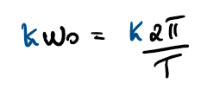
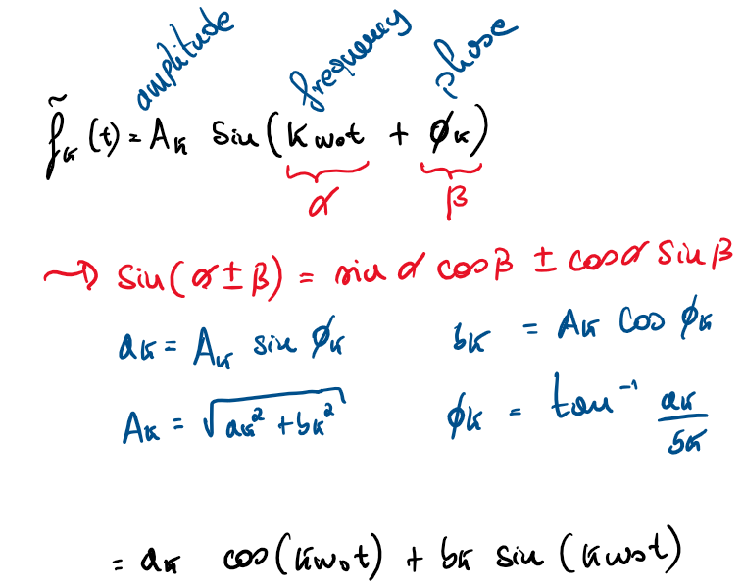
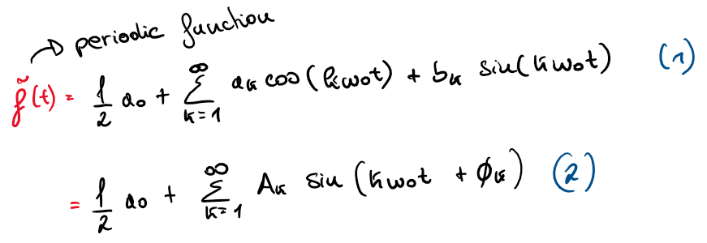
1.1
Fourier series is a representation of a periodic function, based on a summation of sine and cosine functions.
Let’s assume the period is T, then we will sum up sinusoids with frequencies that are multiples of . Each sum is represented by a value k.
Notes:
We represent the kth sinusoidal function with its amplitude, frequency, and phase, because of the sin() formula, we can develop and get the formula with cos and sin, as well as the REAL coefficients ak and bk
With these formulas in mind, we can introduce the following formulas :
These formulas are the same, as shown by the computations previously

Slide 4
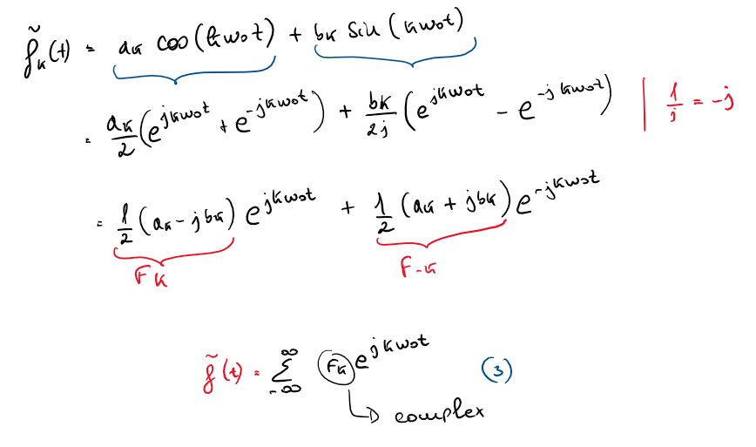
1.1
Finally, by using the conversion formulas, we can compute a third formula from the first one:
Notes:
What we do is we apply the conversion formulas that we saw in the first slide
Then we distribute ak/2 and bk/2
We replace 1/j with –j
We put the terms we can in evidence, (the exponentials) -> which gives us (1/2(ak-jbk)) & the other one
We define them as Fk and F-k, as the only thing that changes is the sign
We change the bounds of the summation! -> Fk is complex obv

Slide 5
Fourier series. Explain the direct and inverse Fourier series computation. Explain why for the continuous time periodic functions do we have discrete Fourier coefficients? You can use an example of periodic square signal to explain the properties of Fourier series coefficients.
1.2
In the future we’ll see the many upsides to working on the Fourier domain, instead of the time domain, however, we need to be able to come back to the time domain after doing all the operations we want to in the Fourier domain.
That will be achieved with the inverse transform.

Slide 6
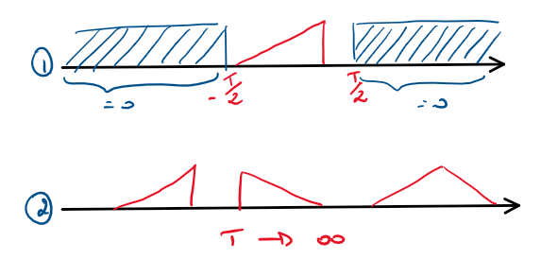
Fourier transform in continuous time and frequency. Explain the transition from periodic functions to aperiodic ones. Explain what is the main difference between the Fourier series and Fourier transform coefficients.
1.3
What we saw with FS, only works if our function is periodic, but in real world applications, functions will, most often than not, be aperiodic.
The goal is to ‘transfer’ the results we had with FS and periodic functions, into aperiodic functions. It’ll be called Fourier Transform.
We have 2 options:
  We can change cancel out the values of our aperiodic function, by multiplying everything outside our interval T, by 0.
  We can set so that the whole aperiodic function becomes a periodic function of period
Notes:
We will work with option (2), and demonstrate how we compute everything

Slide 7

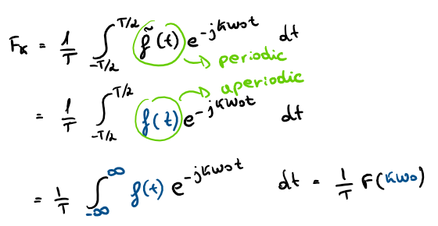
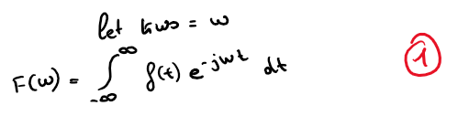
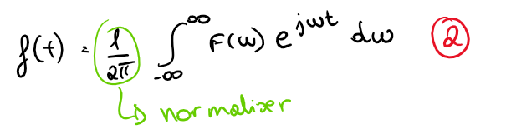
1.3
We defined as inversely proportional to T, so as T grows, becomes smaller.
The ‘consequences’ of this change in can be seen in the following formula:
The following are the new DT and IT formulas:
Notes:
We start, as before, by computing Fk as before between –T/2 and T/2
We can now replace the periodc function with an aperiodic function that is in fact periodic inside the interval of integration
Finally we replace the bounds of integration, from –inf to inf, since T -> inf
We have
(1) DIRECT TRANSFORM
(2) INVERSE TRANSFORM

Slide 8
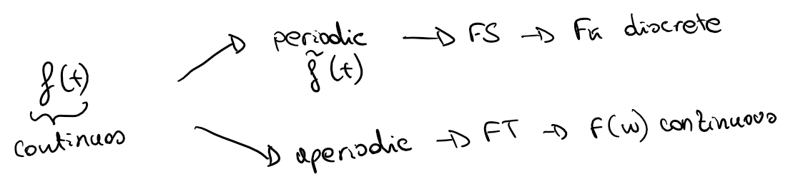
1.3
This leads to the following conclusion :
If f(t) is periodic, we compute FS, and are discrete coefficients.
If f(t) is aperiodic, we compute FT, and are (almost) continuous coefficients.
Notes:
VERY IMPORTANT ---- Fk ----- become continuous coefficients

Slide 9
Fourier transform in continuous time and frequency. Explain Fourier transform as a projection onto complex exponent basis functions. Explain the corresponding properties of real and imaginary parts linking them with the properties of cosine and sine functions.
1.4
First

Slide 10
Fourier transform in continuous time and frequency. Explain properties of Fourier transform under time and frequency shifts.
1.5
There are many reasons as to why we want to work in the Fourier domain instead of time domain, some of the reasons are these properties.

